Slide 1









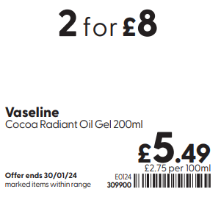

Event 1 2024 Tags
Only £X
BOGOF
X for £Y
Save £X
Save 1/3
½ Price
Better than ½ Price
X for Y
X for £/Y for £
BOGSHP
Now £X
Save XX%

